Slide 1
PowerPoint: memes

Slide 2
When you and your sibling both want the last cookie.

Slide 3
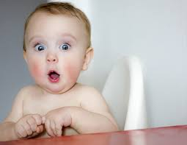
When you do something wrong and you hear Mom coming.

Slide 4
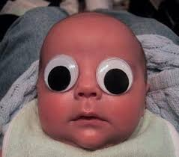
When you refuse to go to sleep.

Slide 5
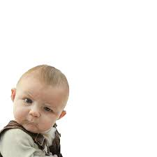
What are you looking at?

Slide 6
When you just got diamonds and you fall in lava:

Slide 7
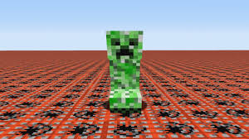
Minecraft players see this in their nightmares…

Slide 8
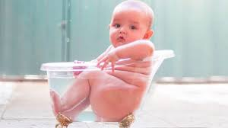
Wait… how do I get out?

Slide 9
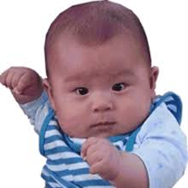
When you tell your baby that you ran out of milk:

Slide 10
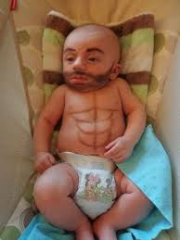
When you want to grow up faster:

Slide 11
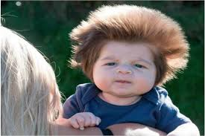
Bad hair day

